Slide 1
DIMENSIONALITY REDUCTION
REF: OCR DATA DOWNLOADED FROM:
http://cmp.felk.cvut.cz/cmp/software/stprtool/
And
The Japanese Female Facial Expression (JAFFE) Database FROM:
http://www.kasrl.org/jaffe.html
CS 557 Statistical Pattern Recognition
Mehreen Saeed
September, 2016

Slide 2
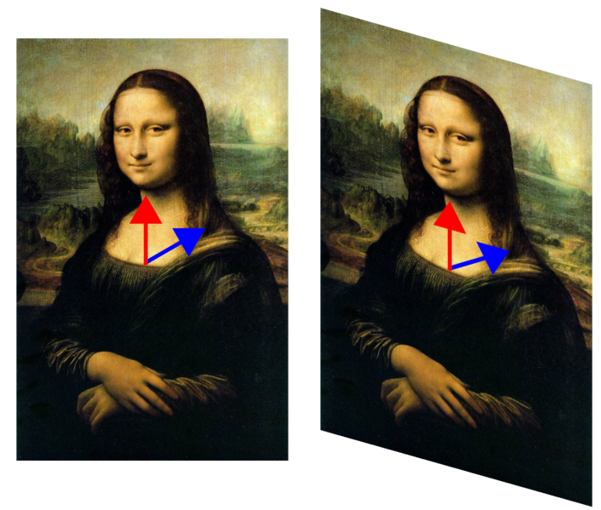

PRE-REQUITES
EXAMPLE OF USING EIGEN VECTORS
Transformation by:
The eigen vector is: [0 c]^{t}
Eigen value = 1
So no change in the vertical direction
Source: www.Wikipedia.org

Slide 3
LDA EXAMPLE … 2 CLASSES
CLASS 1
4 6
2 10
6 0
4 0
CLASS 2
10 1
9 2
2 3
w = const * S_{w}⁻¹(m₁- m₂)
w =
166
-8
*1/2620
μ₁=(4 ,4)
μ₁₂ = (7,2)
NEW MAPPED DATA
Note: we can ignore the constant
class 1
616.0000
252.0000
996.0000
664.0000
class 2
1652 1478
308

Slide 4
Simple Example: 3 class problem
STEP 3
NEW MAPPED DATA
CLASS 1
-1.0896 -6.8132
-5.2632 -7.6375
4.4321 -4.7800
2.9547 -3.1867
CLASS 2
6.7127 -8.5711
5.3000 -8.3789
-0.5448 -3.4066
CLASS 3
-0.3510 -7.6098
-3.1764 -7.2253
CLASS 1
4 6
2 10
6 0
4 0
CLASS 2
10 1
9 2
2 3
CLASS 3
5 6
3 8
μ ₃ = (4, 7)
μ₁ =(4 ,4)
μ ₂ = (7,2)
global mean m= (5,4)
STEP 1
18 -18
-18 30
S_{w}=
-30
-30 76
S_{b}=
eigen values of S_{w}⁻¹S_{b} are:
0.1721, 0.4567
eigen vectors are:
STEP 2
-0.7967 0.7387
-0.6044 -0.6741
Sort the eigen values and corresponding eigen vectors

Slide 5
LINEAR DISCRIMINANT ANALYSIS
Make a transformation z=w^{T}x
Determine w as: S_{w}⁻¹(μ₁- μ₂)
Note: The above is for a 2 class problem and will produce a transformation to 1D
OCR data class 2 vs. class 5
Note the very good separation between the two classes. How would you build your classifier?

Slide 6
LDA FOR MULTI-CLASSES
w is determined as highest eigen vectors associated with eigen values of S_{w}⁻¹S_{b}
Note the very good separation between even multiple classes. How would you build your classifier? (Hint: looks like a great case for Gaussians)

Slide 7
MDS example
16.5600 4.9600 -19.0400 2.3600 -4.8400
4.9600 10.3600 -8.6400 -0.2400 -6.4400
-19.0400 -8.6400 47.3600 -14.2400 -5.440
2.3600 -0.2400 -14.2400 6.1600 5.9600
-4.8400 -6.4400 -5.4400 5.9600 10.7600
B =
Suppose we know D
0 4.1231 10.0995 4.2426 6.0828
4.1231 0 8.6603 4.1231 5.8310
10.0995 8.6603 0 9.0554 8.3066
4.2426 4.1231 9.0554 0 2.2361
6.0828 5.8310 8.3066 2.2361 0
D =
SIDE NOTE:
Suppose we know X
2 3 4
4 5 7
9 10 2
6 2 5
8 2 4
center X, X_{c} = X-1*μ^{T}
-3.8000 -1.4000 -0.4000
-1.8000 0.6000 2.6000
3.2000 5.6000 -2.4000
0.2000 -2.4000 0.6000
2.2000 -2.4000 -0.4000
then B = X_{c}X_{c}^{T}
OR
DOUBLE CENTERING DISTANCE MATRIX
You could use (D2 is distance square matrix):
B = -0.5*h*D2*h
where h is the centering matrix given by:
h = I_{d}-(1/d)*1*1^{T}
(1 is the column of d ones if we have d dimensional space)

Slide 8
ONCE WE HAVE B MATRIX THINGS ARE EASY
find the eigen values λ and corresponding eigen vectors e
sort the eigen values in descending order (along with their eigen vectors)
z_{i}=[sqrt(λ₁)e_{1i} sqrt(λ₂)e_{2i} … sqrt(λ_{k})e_{ki} ]^{T}
here e_{j} is the j^{th} eigen vector and e_{ji} is its ith component
Compute the transformed matrix as:
Z = VS
where V is a matrix with columns as eigen vectors
S is diagonal matrix with entries s_{ii}=sqrt(λ_{i})

Slide 9
WHAT NEXT???
16.5600 4.9600 -19.0400 2.3600 -4.8400
4.9600 10.3600 -8.6400 -0.2400 -6.4400
-19.0400 -8.6400 47.3600 -14.2400 -5.440
2.3600 -0.2400 -14.2400 6.1600 5.9600
-4.8400 -6.4400 -5.4400 5.9600 10.7600
B =
eigen values
62.0009
21.9560
7.2431
0.0000
-0.0000
eigen vectors:
0.3891 0.4176 0.6793 -0.1161 -0.4612
0.1739 0.4669 -0.7146 -0.0371 -0.4832
-0.8689 0.1383 0.1332 -0.2938 -0.4117
0.2439 -0.3305 -0.1003 -0.9061 -0.2413
0.0620 -0.6923 0.0023 0.2789 -0.5711
Why are two columns zeros ??
3.0640 1.9569 1.8283 -0.0000 0 - 0.0000i
1.3692 2.1878 -1.9233 -0.0000 0 - 0.0000i
-6.8419 0.6479 0.3586 -0.0000 0 - 0.0000i
1.9205 -1.5489 -0.2699 -0.0000 0 - 0.0000i
0.4883 -3.2437 0.0063 0.0000 0 - 0.0000i
Z=
take 1,2 or 3 columns

Slide 10
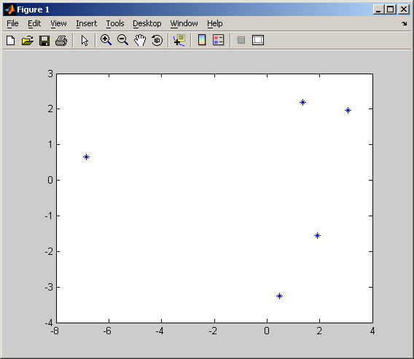
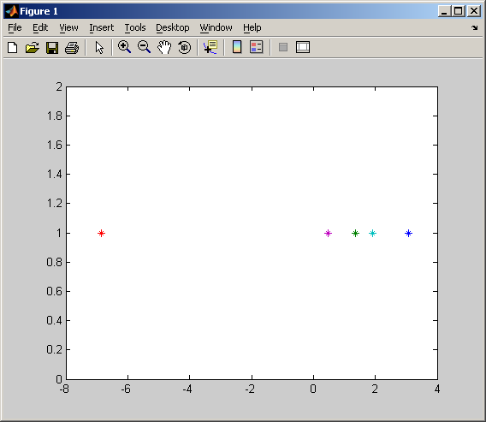
Plot in 1 or 2D
What do the axes represent????

Slide 11
DISTANCE MATRIX OF TRANSFORMED DATA
0 4.1231 10.0995 4.2426 6.0828
4.1231 0 8.6603 4.1231 5.8310
10.0995 8.6603 0 9.0554 8.3066
4.2426 4.1231 9.0554 0 2.2361
6.0828 5.8310 8.3066 2.2361 0
D =
Approximation…but will do
Distance matrix of new 3D data:
0 4.1231 10.0995 4.2426 6.0828
4.1231 0 8.6603 4.1231 5.8310
10.0995 8.6603 0 9.0554 8.3066
4.2426 4.1231 9.0554 0 2.2361
6.0828 5.8310 8.3066 2.2361 0
Distance of new 2D data:
0 1.7105 9.9920 3.6875 5.8035
1.7105 0 8.3542 3.7771 5.5024
9.9920 8.3542 0 9.0336 8.2991
3.6875 3.7771 9.0336 0 2.2190
5.8035 5.5024 8.2991 2.2190 0
More info is lost!
Distance of new 1D data
0 1.6948 9.9059 1.1435 2.5757
1.6948 0 8.2111 0.5513 0.8809
9.9059 8.2111 0 8.7624 7.3302
1.1435 0.5513 8.7624 0 1.4322
2.5757 0.8809 7.3302 1.4322 0
Compare this with the original distance matrix!!!!AMAZING!

Slide 12
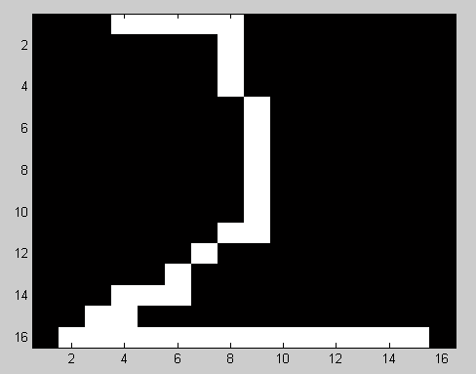
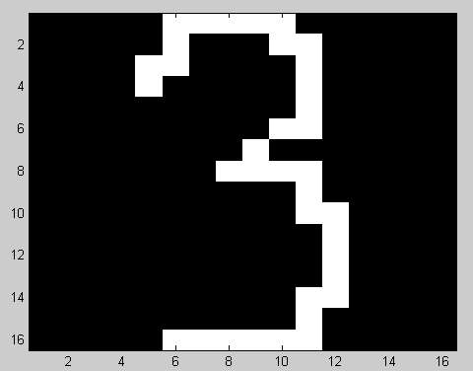
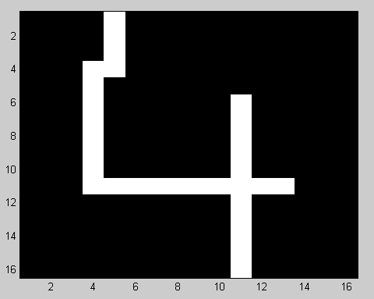
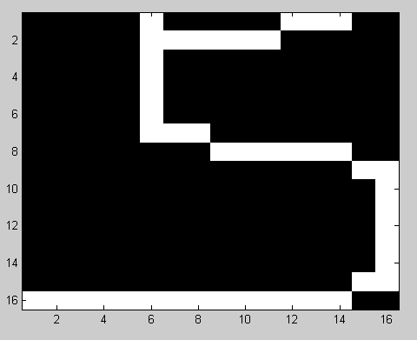
DATABASE: EXAMPLE IMAGES
16x16 images
Binary images
Hand written characters
REF: OCR DATA DOWNLOADED FROM:
http://cmp.felk.cvut.cz/cmp/software/stprtool/
(same as your assignment digit 2 vs. digit 5)

Slide 13
STEPS
We have N images each of dimension 16x16, so X is N x 256
Center the data
Find B = XX^{T} (Do we need distance matrix???)
Find the eigen vectors and corresponding eigen values of B
Z (an approximation of X) can be estimated as CD^{½}. (See Aplaydin’s notation)
Take the first K eigen vectors for dimensionality reduction

Slide 14
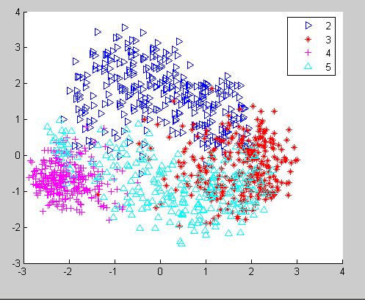
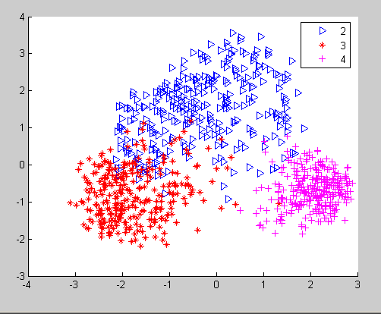
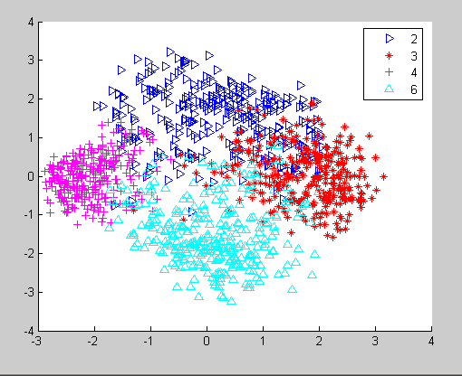
EMBEDDING OF DIGITS IN 2D…(here Z is Nx2)…What do the axis mean???
What a nice separation of digits even in 2D
We can now train a classifier to learn these shapes with only 2 dimensional data instead of 256!!!

Slide 15
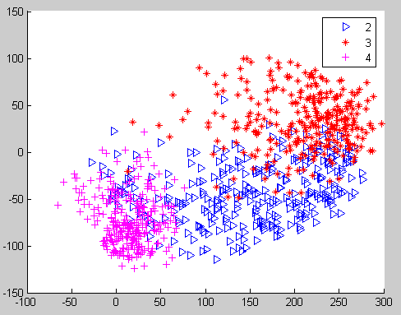
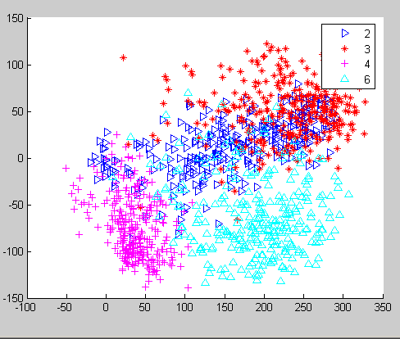
COMPARE WITH PCA…PROJECTING ALONG FIRST 2 EIGEN DIGITS…what do axis represent???
PCA
MDS

Slide 16
LOCALLY LINEAR EMBEDDING
Spiral can be explained in 1D using r = exp(-0.2θ)

Slide 17
LOCALLY LINEAR EMBEDDING
Assumes K = 2
1 1 1
2 1 0
1 0 1
2 1 1
3 1 2
X =
Initial data matrix
STEP 1:
Compute the distance / distance square matrix
(Side note: This could even be similarity matrix but close would mean max similarity)
0 2 1 1 5
2 0 3 1 5
1 3 0 2 6
1 1 2 0 2
5 5 6 2 0
Tells us which points are closest to which
D =

Slide 18
LOCALLY LINEAR EMBEDDING…contd
STEP 2:
Compute the weight matrix :
i^{th} row tells us how to construct the ith point from the K nearest points with minimum errors
0 0 0.5000 0.5000 0
0 0 0 1.0000 0
1.0 0 0 0 0
0.5 0.5 0 0 0
-1 0 0 2.0000 0
W =
STEP 3:
Compute the M matrix :
M = (I-W)^{T}(I-W)
STEP 4:
Compute the eigen values E and eigen vectors V of M
0.4472 0.4139 0.0093 -0.6197 0.4945
0.4472 -0.2128 -0.7961 0.3037 0.1693
0.4472 0.5658 0.3068 0.6093 -0.1201
0.4472 -0.0925 -0.0400 -0.3805 -0.8031
0.4472 -0.6743 0.5199 0.0873 0.2595
-0.0000
0.1119
1.1717
2.6195
9.0969
V =
E =

Slide 19
LOCALLY LINEAR EMBEDDING…contd
STEP 5… FINAL STEP
Retain the d smallest eigen values and their d smallest eigen vectors.
They define the embedding in the new space. Note the smallest eigen vector is normally a constant, so it is not included
Pts in 2D
Pts in 1D
0.4139 0.0093
-0.2128 -0.7961
0.5658 0.3068
-0.0925 -0.0400
-0.6743 0.5199
0.4139
-0.2128
0.5658
-0.0925
-0.6743
We can go up to 4D

Slide 20
LOCALLY LINEAR EMBEDDING … EXAMPLE 2
1 2 0
3 5 0
5 2 5
8 4 1
1 1 2
0 0 1
2 2 1
Assumes K = 3
X =
Initial data matrix
STEP 1-2: The computed W matrix for K=3
0 0 0 0 -1.0000 0.7500 1.2500
-0.0000 0 0 0 -1.6667 0 2.6667
0 0 0 1.1071 3.2857 0 -3.3929
0 1.1606 0.7664 0 0 0 -0.9270
-0.6667 0 0 0 0 0.6667 1.0000
1.0000 0 0 0 1.3333 0 -1.3333
0.7143 0 0 0 0.8571 -0.5714 0
W =

Slide 21
STEP 3: Compute the M matrix : M = (I-W)^{T}(I-W)
2.9546 0.0000 0 0 3.6122 -2.6026 -3.9643
0.00 2.3470 0.8895 -1.1606 1.6667 0 -3.7425
0 0.8895 1.5874 -1.8736 -3.2857 0 2.6824
0 -1.1606 -1.8736 2.2258 3.6378 0 -2.8294
3.6122 1.6667 -3.2857 3.6378 18.0862 -3.2398 -20.4773
-2.6026 0 0 0 -3.2398 2.3335 3.5089
-3.9643 -3.7425 2.6824 -2.8294 -20.4773 3.5089 24.8222
M =
Compute the eigen values E and eigen vectors V of M
0.3780 -0.2311 -0.2926 0.4542 0.6667 -0.2235 -0.1317
0.3780 -0.4432 0.4868 0.0627 -0.3859 -0.5135 -0.0850
0.3780 0.7715 -0.0450 -0.1660 0.0073 -0.4721 0.0966
0.3780 0.2946 0.5211 0.3997 0.0154 0.5725 -0.1049
0.3780 -0.1052 -0.1262 -0.6132 0.0644 0.2304 -0.6301
0.3780 -0.0539 -0.6184 0.2607 -0.5929 0.1965 0.1172
0.3780 -0.2327 0.0743 -0.3981 0.2250 0.2097 0.7378
0.0000
0.0002
0.0191
0.0597
4.2803
5.2391
44.7582
E =
V =
E=
Note: the first vector can be ignored as its corresponding eigen value = 0

Slide 22
FINAL EMBEDDING …
Ignore the smallest eigen value (0) and take the rest …
Y= VD^{1/2} (D is the diagonal matrix containing sqrt of eigen values)
-0.0036 -0.0405 0.1110 1.3793 -0.5116 -0.8812
-0.0069 0.0673 0.0153 -0.7984 -1.1754 -0.5685
0.0120 -0.0062 -0.0406 0.0152 -1.0806 0.6463
0.0046 0.0721 0.0977 0.0320 1.3105 -0.7018
-0.0016 -0.0175 -0.1498 0.1332 0.5273 -4.2152
-0.0008 -0.0855 0.0637 -1.2267 0.4499 0.7842
-0.0036 0.0103 -0.0973 0.4654 0.4799 4.9362
Y =
New mapping has up to 6 dimensions but generally you won’t take more than 3

Slide 23
LLE ON OCR DATASET
k=5
k=30
Note: Values were not scaled by square root of eigen values

